Slide 1
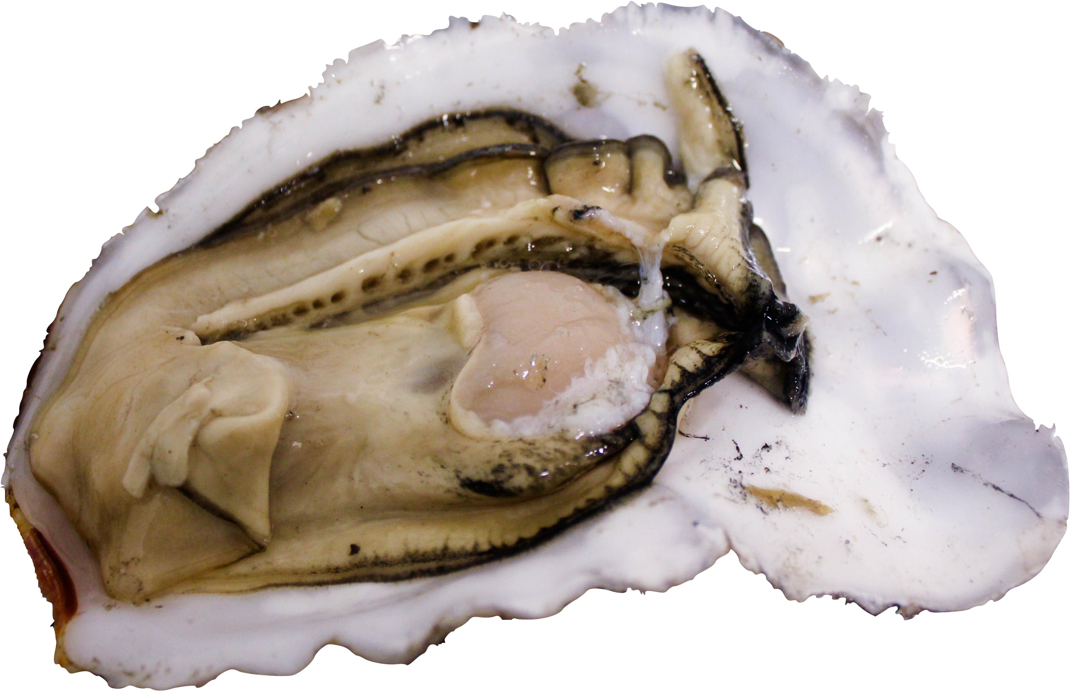

Pre-Gametogenic pH Exposure Induces Larval Carryover Effect
Yaamini Venkataraman
University of Washington, Seattle
@YaaminiV

Slide 2
Unfertilized egg
Adult
Trocophore
Pacific oyster (Crassostrea gigas)
D-hinge
Spat
Pediveliger
Veliger

Slide 3
Unfertilized egg
Adult
Trocophore
Sperm inactive at pH < 7.0
Boulais et al. 2018
D-hinge
Spat
Pediveliger
Veliger
Notes:
Still need to add references

Slide 4
Unfertilized egg
Adult
Trocophore
Sperm inactive at pH < 7.0
Boulais et al. 2018
D-hinge
Spat
Developmental delays
Timmins-Schiffman et al. 2012
Pediveliger
Veliger
Notes:
Still need to add references

Slide 5
Unfertilized egg
Adult
Trocophore
Sperm inactive at pH < 7.0
Boulais et al. 2018
D-hinge
Spat
Reduced settlement
Developmental delays
Burton et al., NSA 2018
Timmins-Schiffman et al. 2012
Pediveliger
Veliger
Notes:
Still need to add references

Slide 6
Unfertilized egg
Altered proteomic profile
Adult
Trocophore
Timmins-Schiffman et al. 2014
Sperm inactive at pH < 7.0
Boulais et al. 2018
D-hinge
Spat
Reduced settlement
Developmental delays
Burton et al., NSA 2018
Timmins-Schiffman et al. 2012
Pediveliger
Veliger
Notes:
Still need to add references

Slide 7
Unfertilized egg
Altered proteomic profile
Adult
Trocophore
Timmins-Schiffman et al. 2014
Sperm inactive at pH < 7.0
Boulais et al. 2018
D-hinge
Spat
Reduced settlement
Developmental delays
Burton et al., NSA 2018
Timmins-Schiffman et al. 2012
Pediveliger
Veliger
Notes:
Still need to add references

Slide 8
Unfertilized egg
Adult
Trocophore
?
D-hinge
Spat
Pediveliger
Veliger
Notes:
Still need to add references

Slide 9
Does pre-gametogenic exposure result in carryover effects in larvae?
Notes:
PRECONDITIONING IN DIFFERENT PHS → DOWNSTREAM EFFECTS ON EVERYTHING ELSE
Everything else is a validity of the hatch rate
Only difference is the 7 week period → no difference in pre and post maturation stages
Verify there was no direct effect

Slide 10
7 week pH exposure
150 oysters
Notes:
150 sibling oysters. Sampled gonad, or reproductive tissue, from 20 individuals
Exposed remaining oysters to either ambient or low pH treatments for 7 weeks
Sampled 10 per treatment after exposure

Slide 11
7 week pH exposure
150 oysters
8 week
ambient conditions
Notes:
150 sibling oysters. Sampled gonad, or reproductive tissue, from 20 individuals
Exposed remaining oysters to either ambient or low pH treatments for 7 weeks
Sampled 10 per treatment after exposure

Slide 12
7 week pH exposure
150 oysters
8 week
ambient conditions
8 week
conditioning (23ºC)
Notes:
150 sibling oysters. Sampled gonad, or reproductive tissue, from 20 individuals
Exposed remaining oysters to either ambient or low pH treatments for 7 weeks
Sampled 10 per treatment after exposure

Slide 13
7 week pH exposure
150 oysters
8 week
ambient conditions
8 week
conditioning (23ºC)
Spawn
Notes:
SPAWN IN AMBIENT CONDITIONS

Slide 14
7 week pH exposure
150 oysters
8 week
ambient conditions
8 week
conditioning (23ºC)
Spawn
Notes:
150 sibling oysters. Sampled gonad, or reproductive tissue, from 20 individuals
Exposed remaining oysters to either ambient or low pH treatments for 7 weeks
Sampled 10 per treatment after exposure

Slide 15
Pre-treatment sampling
(n = 20)
150 oysters
Notes:
150 sibling oysters. Sampled gonad, or reproductive tissue, from 20 individuals
Exposed remaining oysters to either ambient or low pH treatments for 7 weeks
Sampled 10 per treatment after exposure

Slide 16
Pre-treatment sampling
(n = 20)
150 oysters
Notes:
150 sibling oysters. Sampled gonad, or reproductive tissue, from 20 individuals
Exposed remaining oysters to either ambient or low pH treatments for 7 weeks
Sampled 10 per treatment after exposure

Slide 17
Pre-treatment sampling
(n = 20)
150 oysters
7 week pH exposure
Notes:
150 sibling oysters. Sampled gonad, or reproductive tissue, from 20 individuals
Exposed remaining oysters to either ambient or low pH treatments for 7 weeks
Sampled 10 per treatment after exposure

Slide 18
Pre-treatment sampling
(n = 20)
150 oysters
7 week pH exposure
Ambient
(8.0)
Low
(7.4)
Notes:
150 sibling oysters. Sampled gonad, or reproductive tissue, from 20 individuals
Exposed remaining oysters to either ambient or low pH treatments for 7 weeks
Sampled 10 per treatment after exposure

Slide 19
Pre-treatment sampling
(n = 20)
150 oysters
7 week pH exposure
Post-treatment sampling
(n = 10)
Post-treatment sampling
(n = 10)
Ambient
(8.0)
Low
(7.4)
Notes:
150 sibling oysters. Sampled gonad, or reproductive tissue, from 20 individuals
Exposed remaining oysters to either ambient or low pH treatments for 7 weeks
Sampled 10 per treatment after exposure

Slide 20
Pre-treatment sampling
(n = 20)
150 oysters
7 week pH exposure
Post-treatment sampling
(n = 10)
Post-treatment sampling
(n = 10)
Ambient
(8.0)
Low
(7.4)
Notes:
150 sibling oysters. Sampled gonad, or reproductive tissue, from 20 individuals
Exposed remaining oysters to either ambient or low pH treatments for 7 weeks
Sampled 10 per treatment after exposure

Slide 21
Pre-treatment sampling
(n = 20)
150 oysters
Confirmed lack of mature gonad tissue (p = 0.3442)
7 week pH exposure
Post-treatment sampling
(n = 10)
Post-treatment sampling
(n = 10)
Ambient
(8.0)
Low
(7.4)
Notes:
150 sibling oysters. Sampled gonad, or reproductive tissue, from 20 individuals
Exposed remaining oysters to either ambient or low pH treatments for 7 weeks
Sampled 10 per treatment after exposure

Slide 22
Pre-treatment sampling
(n = 20)
150 oysters
Confirmed lack of mature gonad tissue (p = 0.3442)
7 week pH exposure
Post-treatment sampling
(n = 10)
Post-treatment sampling
(n = 10)
Ambient
(8.0)
Low
(7.4)
8 week
ambient conditions
8 week
conditioning (23ºC)
Remaining oysters
Spawn
Notes:
150 sibling oysters. Sampled gonad, or reproductive tissue, from 20 individuals
Exposed remaining oysters to either ambient or low pH treatments for 7 weeks
Sampled 10 per treatment after exposure

Slide 23
Pre-treatment sampling
(n = 20)
150 oysters
Confirmed lack of mature gonad tissue (p = 0.3442)
7 week pH exposure
Post-treatment sampling
(n = 10)
Post-treatment sampling
(n = 10)
Ambient
(8.0)
Low
(7.4)
8 week
ambient conditions
8 week
conditioning (23ºC)
Remaining oysters
Spawn
Notes:
150 sibling oysters. Sampled gonad, or reproductive tissue, from 20 individuals
Exposed remaining oysters to either ambient or low pH treatments for 7 weeks
Sampled 10 per treatment after exposure

Slide 24
Strip spawn
Notes:
Equal number of eggs per cross
Equal number of sperm from males
Created 6 crosses, 2 reps each per family (total n = 12)

Slide 25
Strip spawn
1g mature gonad per female
Notes:
Equal number of eggs per cross
Equal number of sperm from males
Created 6 crosses, 2 reps each per family (total n = 12)

Slide 26
Strip spawn
1g mature gonad per female
Pool
Pool
Low
Ambient
Notes:
Equal number of eggs per cross
Equal number of sperm from males
Created 6 crosses, 2 reps each per family (total n = 12)

Slide 27
Strip spawn
1g mature gonad per female
Pool
Pool
Experimental crosses
210,000 eggs per cross
Pool
Pool
Low
Ambient
Notes:
Equal number of eggs per cross
Equal number of sperm from males
Created 6 crosses, 2 reps each per family (total n = 12)

Slide 28
Strip spawn
1g mature gonad per female
Pool
Pool
Experimental crosses
210,000 eggs per cross
Pool
Pool
200 µL sperm per cross
1
2
3
4
5
6
1
2
3
4
5
6
Low
Ambient
Notes:
Equal number of eggs per cross
Equal number of sperm from males
Created 6 crosses, 2 reps each per family (total n = 12)

Slide 29
Strip spawn
1g mature gonad per female
Pool
Pool
Experimental crosses
210,000 eggs per cross
Pool
Pool
200 µL sperm per cross
1
2
3
4
5
6
1
2
3
4
5
6
Low
Ambient
Notes:
Equal number of eggs per cross
Equal number of sperm from males
Created 6 crosses, 2 reps each per family (total n = 12)

Slide 30
Families by parental treatment
FL x ML
n = 6
FL x MA
n = 6
FA x ML
n = 6
FA x FA
n = 6
Low
Ambient
Notes:
OUTLINE BOX AROUND DHING LARVAE
Created four families by parental treatment, each with 6 crosses and 2 replicates per cross.
Began fertilization in 1 L tripours
Checked for formation of polar bodies → transferred to 5 gallon buckets
18 hpf: counted d-hinge

Slide 31
Families by parental treatment
FL x ML
n = 6
FL x MA
n = 6
FA x ML
n = 6
FA x FA
n = 6
Begin fertilization in 1L tripours
Low
Ambient
Notes:
OUTLINE BOX AROUND DHING LARVAE
Created four families by parental treatment, each with 6 crosses and 2 replicates per cross.
Began fertilization in 1 L tripours
Checked for formation of polar bodies → transferred to 5 gallon buckets
18 hpf: counted d-hinge

Slide 32
Families by parental treatment
FL x ML
n = 6
FL x MA
n = 6
FA x ML
n = 6
FA x FA
n = 6
Begin fertilization in 1L tripours
Evidence of polar bodies
Low
Ambient
Notes:
Created four families by parental treatment, each with 6 crosses and 2 replicates per cross.
Began fertilization in 1 L tripours
Checked for formation of polar bodies → transferred to 5 gallon buckets
18 hpf: counted d-hinge

Slide 33
Families by parental treatment
FL x ML
n = 6
FL x MA
n = 6
FA x ML
n = 6
FA x FA
n = 6
Begin fertilization in 1L tripours
Evidence of polar bodies
Transfer to 5 gallon buckets
Low
Ambient
Notes:
OUTLINE BOX AROUND DHING LARVAE
Created four families by parental treatment, each with 6 crosses and 2 replicates per cross.
Began fertilization in 1 L tripours
Checked for formation of polar bodies → transferred to 5 gallon buckets
18 hpf: counted d-hinge

Slide 34
Families by parental treatment
FL x ML
n = 6
FL x MA
n = 6
FA x ML
n = 6
FA x FA
n = 6
Begin fertilization in 1L tripours
Evidence of polar bodies
Transfer to 5 gallon buckets
18 hours post fertilization
Low
Ambient
Notes:
OUTLINE BOX AROUND DHING LARVAE
Created four families by parental treatment, each with 6 crosses and 2 replicates per cross.
Began fertilization in 1 L tripours
Checked for formation of polar bodies → transferred to 5 gallon buckets
18 hpf: counted d-hinge

Slide 35
Families by parental treatment
FL x ML
n = 6
FL x MA
n = 6
FA x ML
n = 6
FA x FA
n = 6
Begin fertilization in 1L tripours
Evidence of polar bodies
Transfer to 5 gallon buckets
18 hours post fertilization
Count D-hinge larvae
Low
Ambient
Notes:
OUTLINE BOX AROUND DHING LARVAE
Created four families by parental treatment, each with 6 crosses and 2 replicates per cross.
Began fertilization in 1 L tripours
Checked for formation of polar bodies → transferred to 5 gallon buckets
18 hpf: counted d-hinge

Slide 36
1.0
0.8
Proportion live larvae
0.6
0.4
0.2
Notes:
Females are the ones that take more energy → is there an effect there?
Pool → increase power
We found that hatch rates for a cross were significantly reduced if the female in that cross was exposed to low pH
Could be due to a couple of things: low pH females were producing the same amount of eggs, but perhaps they were poor quality. Barrier to fertilization that we didn’t study

Slide 37
F Ambient x
M Ambient
n = 6
1.0
0.8
Proportion live larvae
0.6
0.4
Low
0.2
Ambient
Notes:
Females are the ones that take more energy → is there an effect there?
Pool → increase power
We found that hatch rates for a cross were significantly reduced if the female in that cross was exposed to low pH
Could be due to a couple of things: low pH females were producing the same amount of eggs, but perhaps they were poor quality. Barrier to fertilization that we didn’t study

Slide 38
F Ambient x
M Ambient
F Ambient x
M Low
n = 6
n = 6
1.0
0.8
Proportion live larvae
0.6
0.4
Low
0.2
Ambient
Notes:
Females are the ones that take more energy → is there an effect there?
Pool → increase power
We found that hatch rates for a cross were significantly reduced if the female in that cross was exposed to low pH
Could be due to a couple of things: low pH females were producing the same amount of eggs, but perhaps they were poor quality. Barrier to fertilization that we didn’t study

Slide 39
F Ambient x
M Ambient
F Ambient x
M Low
F Low x
M Ambient
n = 6
n = 6
n = 6
1.0
0.8
Proportion live larvae
0.6
0.4
Low
0.2
Ambient
Notes:
Females are the ones that take more energy → is there an effect there?
Pool → increase power
We found that hatch rates for a cross were significantly reduced if the female in that cross was exposed to low pH
Could be due to a couple of things: low pH females were producing the same amount of eggs, but perhaps they were poor quality. Barrier to fertilization that we didn’t study

Slide 40
F Ambient x
M Ambient
F Ambient x
M Low
F Low x
M Ambient
F Low x
M Low
n = 6
n = 6
n = 6
n = 6
1.0
0.8
Proportion live larvae
0.6
0.4
Low
0.2
Ambient
Notes:
Females are the ones that take more energy → is there an effect there?
Pool → increase power
We found that hatch rates for a cross were significantly reduced if the female in that cross was exposed to low pH
Could be due to a couple of things: low pH females were producing the same amount of eggs, but perhaps they were poor quality. Barrier to fertilization that we didn’t study

Slide 41
F Ambient x
M Ambient
F Ambient x
M Low
F Low x
M Ambient
F Low x
M Low
n = 6
n = 6
n = 6
n = 6
1.0
All families:
F = 3.0276
p = 0.0533
0.8
Proportion live larvae
0.6
0.4
Low
0.2
Ambient
Notes:
Females are the ones that take more energy → is there an effect there?
Pool → increase power
We found that hatch rates for a cross were significantly reduced if the female in that cross was exposed to low pH
Could be due to a couple of things: low pH females were producing the same amount of eggs, but perhaps they were poor quality. Barrier to fertilization that we didn’t study

Slide 42
Ambient pH Females
Low pH Females
n = 12
n = 12
1.0
0.8
Proportion live larvae
0.6
0.4
Low
0.2
Ambient
Notes:
Females are the ones that take more energy → is there an effect there?
Pool → increase power
We found that hatch rates for a cross were significantly reduced if the female in that cross was exposed to low pH
Could be due to a couple of things: low pH females were producing the same amount of eggs, but perhaps they were poor quality. Barrier to fertilization that we didn’t study

Slide 43
Ambient pH Females
Low pH Females
n = 12
n = 12
1.0
Female treatment:
t = 3.162
p = 0.0045
0.8
Proportion live larvae
0.6
0.4
Low
0.2
Ambient
Notes:
Females are the ones that take more energy → is there an effect there?
Pool → increase power
We found that hatch rates for a cross were significantly reduced if the female in that cross was exposed to low pH
Could be due to a couple of things: low pH females were producing the same amount of eggs, but perhaps they were poor quality. Barrier to fertilization that we didn’t study

Slide 44
Maternal effect on larval abundance
Ambient pH Females
Low pH Females
n = 12
n = 12
1.0
Female treatment:
t = 3.162
p = 0.0045
0.8
Proportion live larvae
0.6
0.4
Low
0.2
Ambient
Notes:
Females are the ones that take more energy → is there an effect there?
Pool → increase power
We found that hatch rates for a cross were significantly reduced if the female in that cross was exposed to low pH

Slide 45
Unfertilized egg
Adult
Trocophore
Pre-gametogenic exposure in females reduces D-hinge abundance
D-hinge
Spat
Settlement effects
Larval
survival
Pediveliger
Veliger
Notes:
Could be due to a couple of things: low pH females were producing the same amount of eggs, but perhaps they were poor quality. Barrier to fertilization that we didn’t study
Remarkable part: Did this 4 months BEFORE conditioning (OA imparis larval output)
Related but different question than typical transgenerational experiments → developing into mature gametes there was no stressor
Broader perspective of timing in environmental change → when it occurs, and whether or not if affects the next generation
Implications in aquaculture (small scale cannot buffer the water they bring in, if you are able to modulate but something happens, one-off events in the wild)
HOW EARLY DOES THAT EXPSOURE NEED TO BE? → gradients in exposure time, lag time

Slide 46
Unfertilized egg
Adult
Trocophore
Egg quality Fertilization barrier
Pre-gametogenic exposure in females reduces D-hinge abundance
D-hinge
Spat
Pediveliger
Veliger
Notes:
Follow up questions:
HOW EARLY DOES THAT EXPSOURE NEED TO BE? → gradients in exposure time, lag time
Fertilization barrier, egg quality, larvae and spat

Slide 47
Unfertilized egg
Adult
Trocophore
Egg quality Fertilization barrier
Pre-gametogenic exposure in females reduces D-hinge abundance
D-hinge
Spat
Larval
survival
Pediveliger
Veliger
Notes:
Follow up questions:
Fertilization barrier, egg quality, larvae and spat

Slide 48
Unfertilized egg
Adult
Trocophore
Egg quality Fertilization barrier
Pre-gametogenic exposure in females reduces D-hinge abundance
D-hinge
Spat
Settlement effects
Larval
survival
Pediveliger
Veliger
Notes:
Follow up questions:
HOW EARLY DOES THAT EXPSOURE NEED TO BE? → gradients in exposure time, lag time
Fertilization barrier, egg quality, larvae and spat

Slide 49
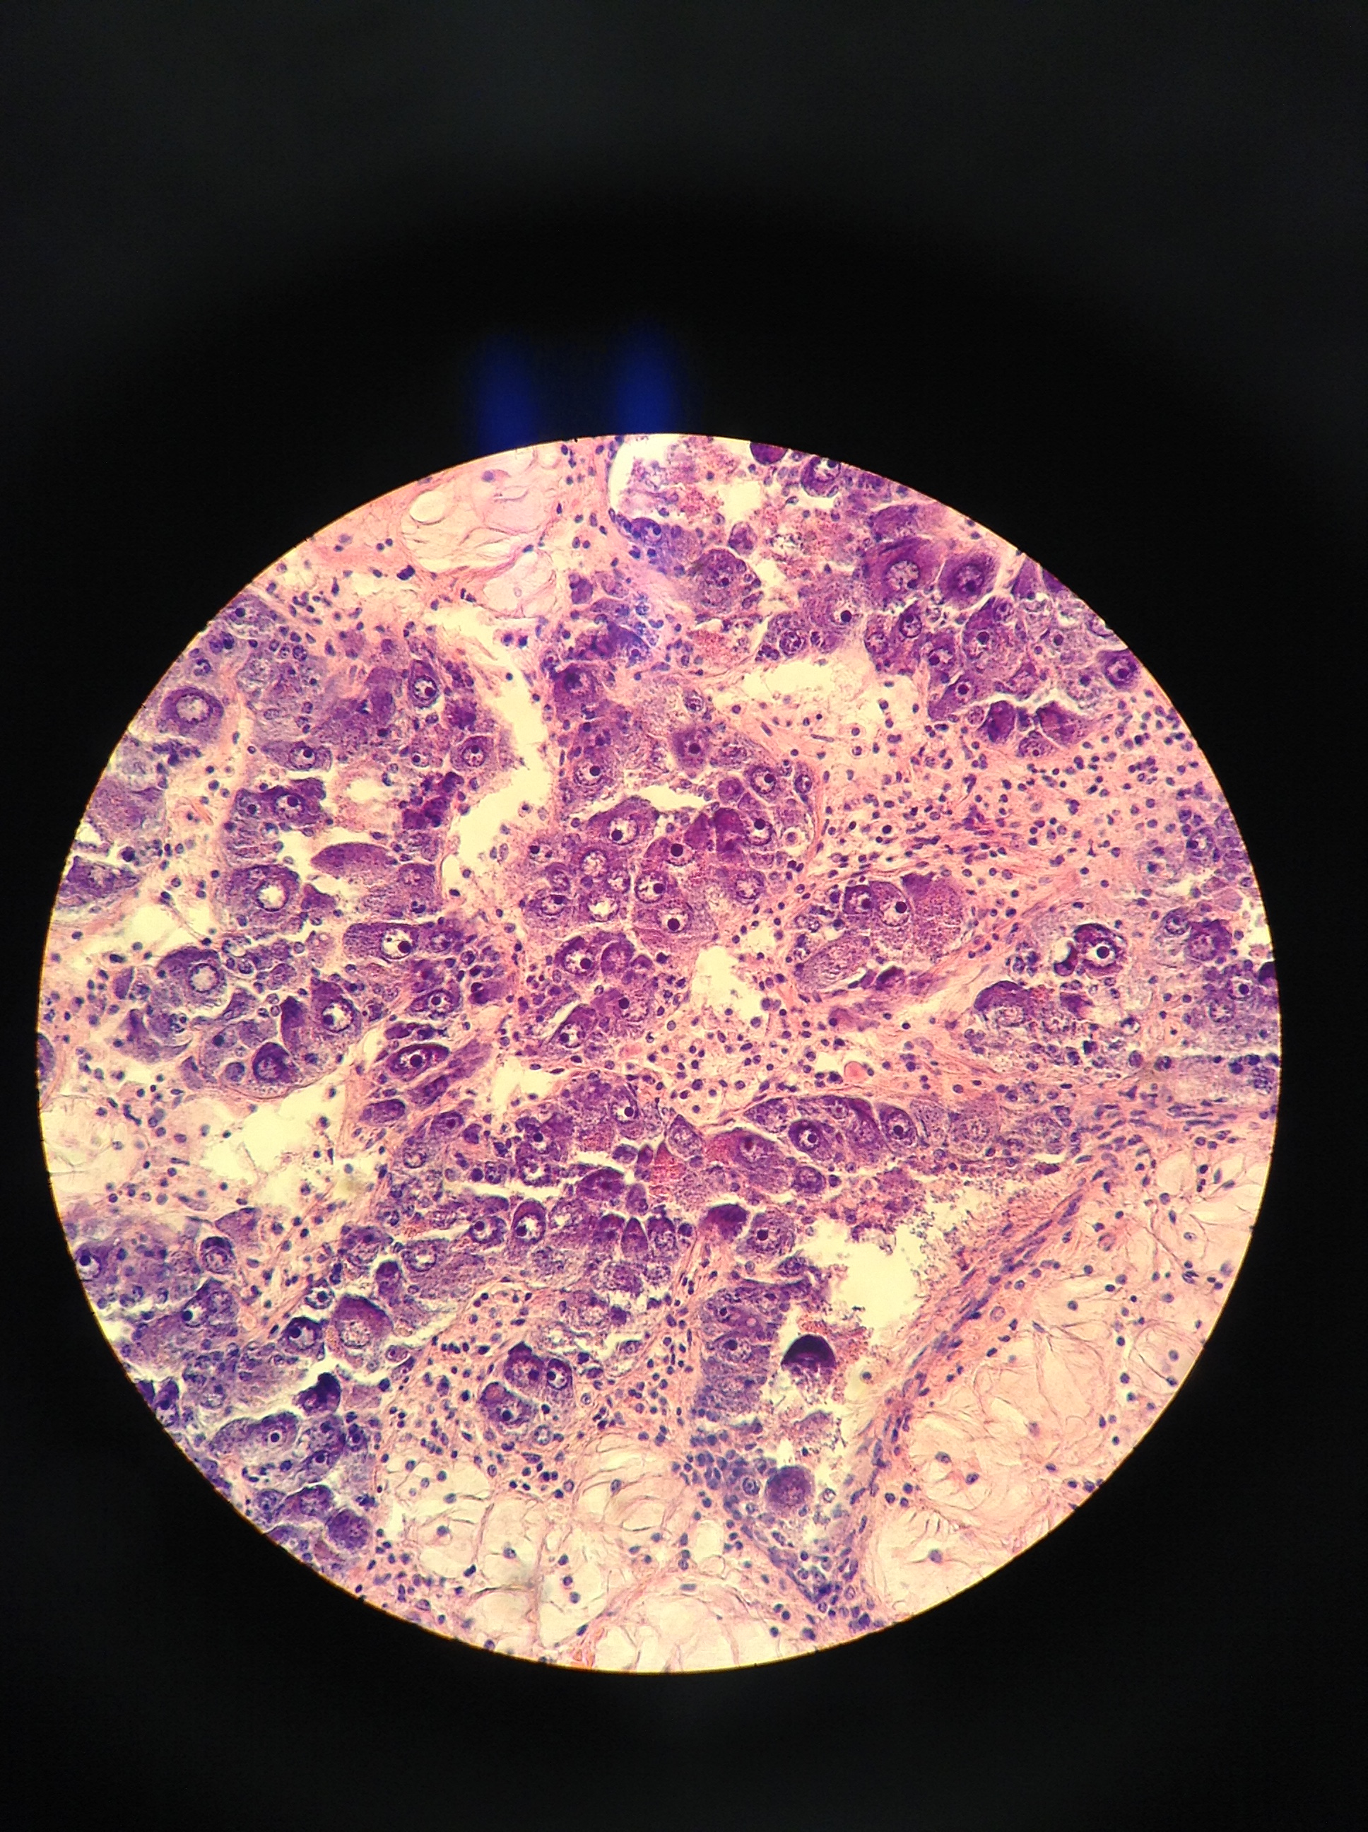
Moving forward: Mechanism
Notes:
What I am most excited about is unravelling the mechanism of that maternal effect we saw
Mechanistic understanding of maternal effect using epigenetics in C. virginica
Environmental stress → epigenome → phenotype
Resource allocation, stress

Slide 50
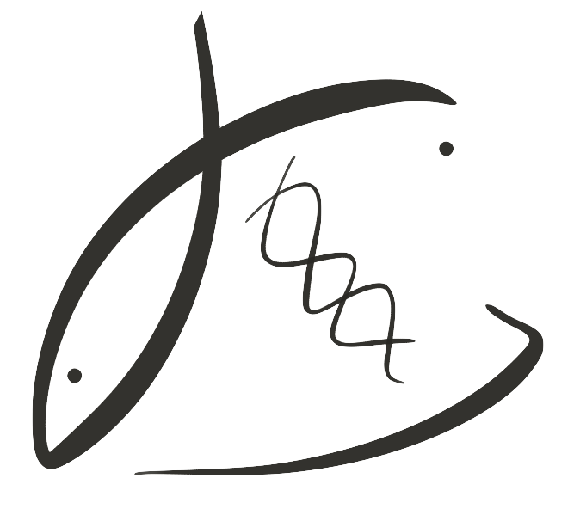





Thank you!
Steven Roberts
Brent Vadopalas
Laura Spencer
Grace Crandall
Kaitlyn Mitchell
Benoit Eudeline
Molly Jackson
Rhonda Elliot
Rick Goetz
Betsy Peabody
Ryan Crim
Stuart Ryan
Jade Austin
Joth Davis
Kelsey Donahue
Ashley Lockhart

Slide 51
Questions?
Yaamini Venkataraman
yaaminiv@uw.edu
bit.ly/project-oyster-oa

